Slide 1
B.Tech – CSE – Sem. 3 18CSS201J – ANALOG AND DIGITAL ELECTRONICS (Regulations 2018)
UNIT 4
Session-8 ( Synthesis of Sequential Circuits, Problem Session)

Slide 2








Synthesis Sequential Circuits:
Design Procedure
The procedure for designing synchronous sequential circuits can be summarized by a list of recommended steps.
From the word description and specifications of the desired
operation, derive a state diagram for the circuit.
2. Reduce the number of states if necessary.
3. Assign binary values to the states.
4. Obtain the binary-coded state table.
5. Choose the type of flip-flops to be used.
6. Derive the simplified flip-flop input equations and output equations.
7. Draw the logic diagram.

Slide 3
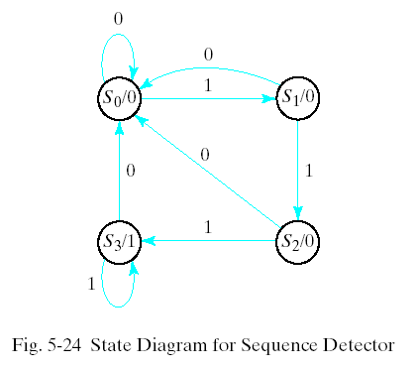























Example D Flip-Flop
Design Procedure

Slide 4




























Slide 5
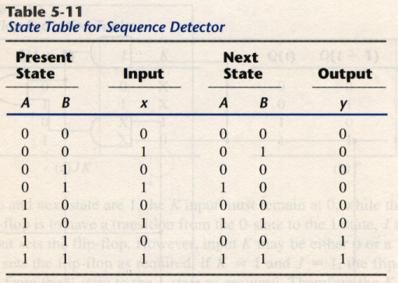


Synthesis Using D Flip-Flops
A(t + 1) = DA(A, B, x) = ∑ (3, 5, 7)
B(t + 1) = DB(A, B, x) = ∑ (1, 5, 7)
y(A, B, x) = ∑ (6, 7)

Slide 6


























A(t + 1) = DA(A, B, x) = ∑ (3, 5, 7)
B(t + 1) = DB(A, B, x) = ∑ (1, 5, 7)
y(A, B, x) = ∑ (6, 7)

Slide 7
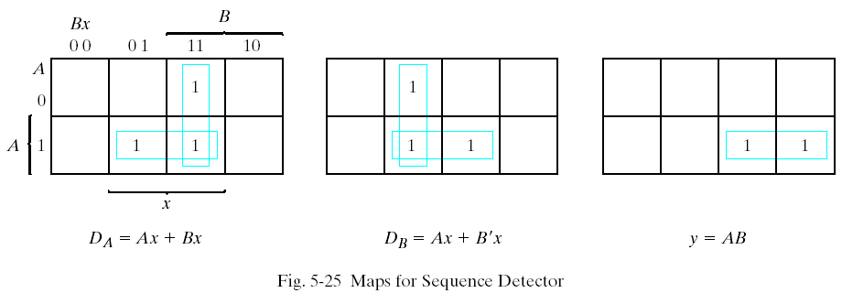


Synthesis Using D Flip-Flops
DA = Ax +Bx
DB = Ax + B`x
y = AB

Slide 8
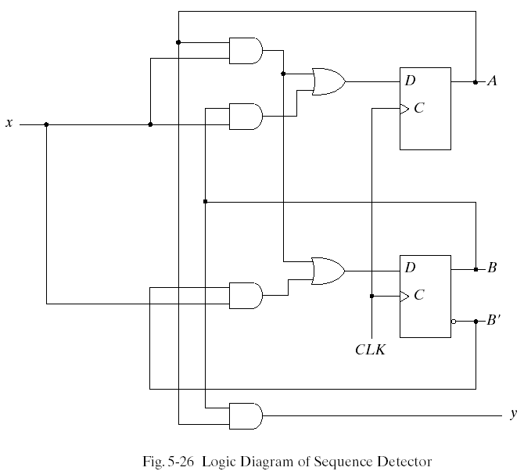











Synthesis Using D Flip-Flops

Slide 9
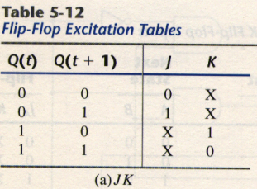
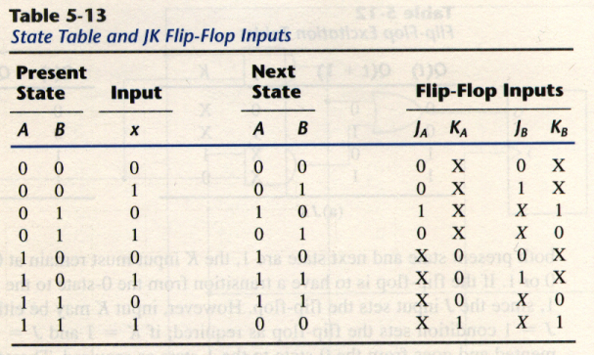
Synthesis Using JK Flip-Flops
Different from Table 5-11 !!
Ref. Table 5-1

Slide 10
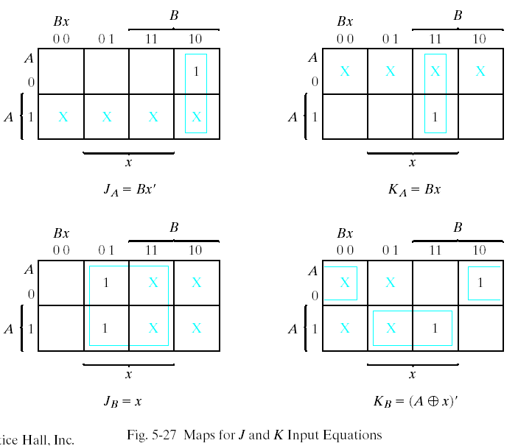
Synthesis Using JK Flip-Flops

Slide 11
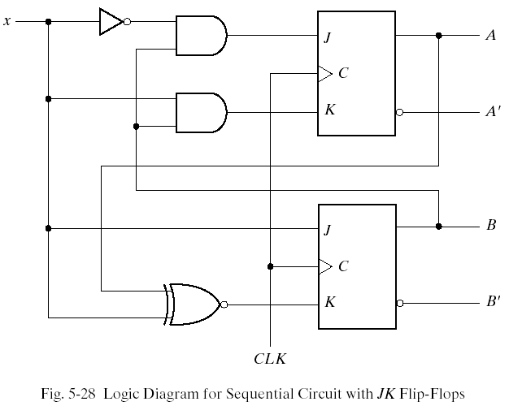
Synthesis Using JK Flip-Flops

Slide 12
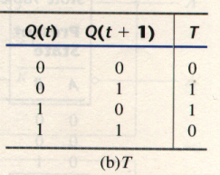
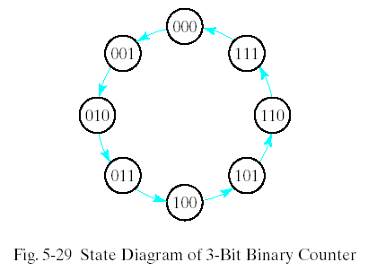
Synthesis Using T Flip-Flops
The synthesis using T flip-flops will be demonstrated by designing a binary counter. An n-bit binary counter consists of n flip-flops that can count in binary from 0 to 2^{n}-1. The state diagram of a 3-bit counter is shown in Fig. 5-29.
Ref. Table 5-1

Slide 13
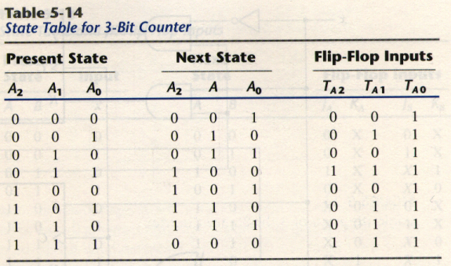
Synthesis Using T Flip-Flops

Slide 14
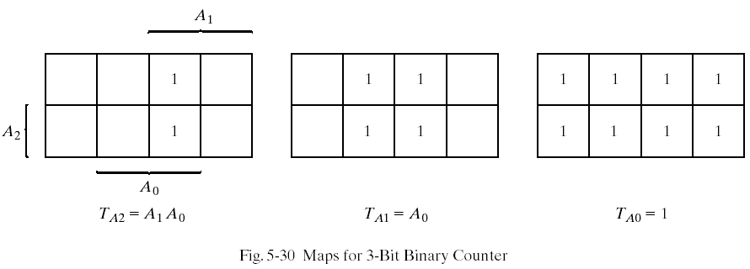
Synthesis Using T Flip-Flops

Slide 15
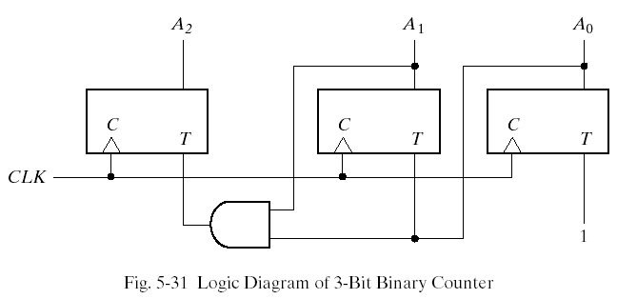
Synthesis Using T Flip-Flops

Slide 16
SUBJECT CODES OF I Semester

Slide 17
SUBJECT CODES OF II Semester
18LEH101J – FRENCH
18LEH101J – GERMAN
18LEH101J – JAPANESE
12MAB102T – MATHS
18CYB101J – CHEMISTRY
18CSS101J – PPS
18PDH101T – GENERAL APTITUDE
18GNM104L – NSO
18MES101L – ENGINEERING GRAPHICS
18LEM102J – VALUE EDUCATION

Slide 18
SUBJECT CODES OF III Semester
18MAB201T - Transforms and Boundary Value Problems
18BTB101T - Biology
18CSS201J - Analog and Digital Electronics
18CSC201J - Data Structure and Algorithms
18CSC202J - Object Oriented Design and Programming
18CSC203J - Computer Organization and Architecture
18PDH102T - Management Principles for Engineers
18PDM201L - Competencies in Social Skills

Slide 19
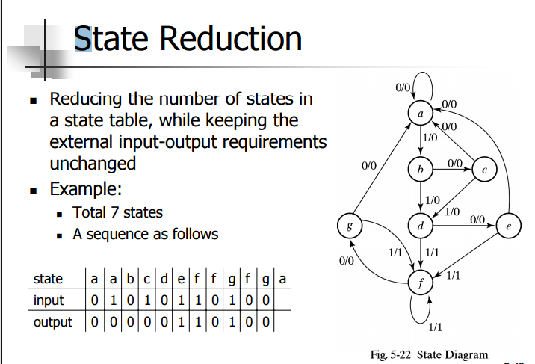










State Reduction and Assignment

Slide 20
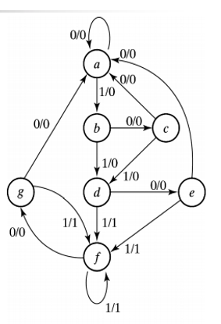
































State Reduction and Assignment

Slide 21
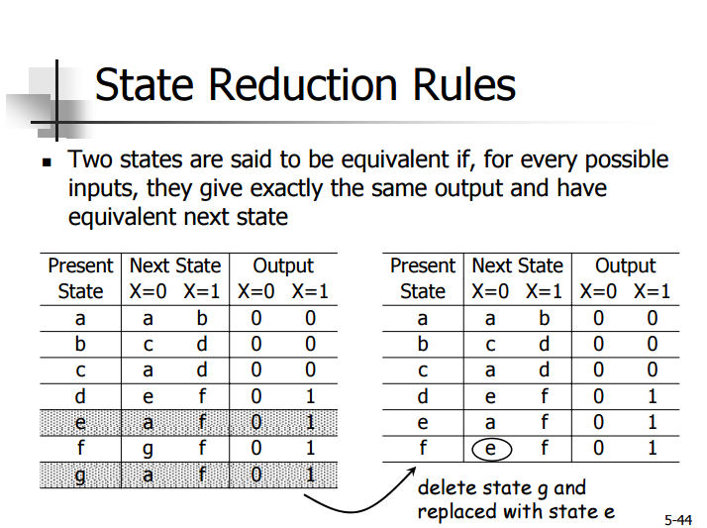
State Reduction and Assignment (Contd.)

Slide 22
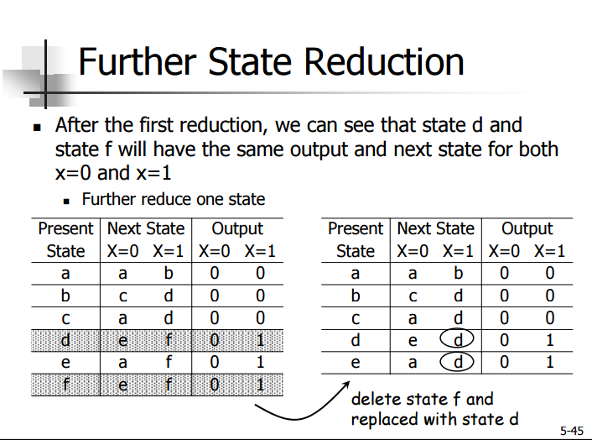
State Reduction and Assignment (Contd.)

Slide 23
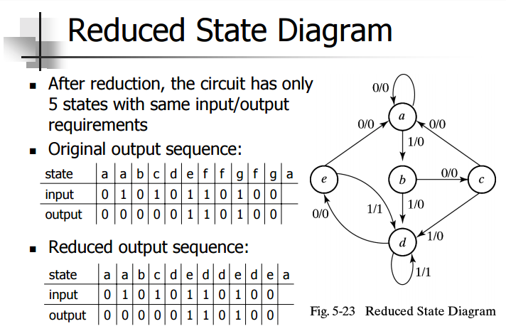
State Reduction and Assignment (Contd.)

Slide 24
State Assignment
State Reduction and Assignment (Contd.)
State
a
b
c
d
e
Binary
000
001
010
011
100
Gray Code
000
001
011
010
110
One-Hot
00001
00010
00100
01000
10000

Slide 25
Reduced State Table: Binary State Assignment
State Reduction and Assignment (Contd.)
Next State x=0 x=1
000 001
010 011
000 011
100 011
000 011
Output x=0 x=1
0 0
0 0
0 0
0 1
0 1
State
001
010
011
100
101

Slide 26
Reduced State Table: Binary State Assignment
State Reduction and Assignment (Contd.)
Next State x=0 x=1
000 001
010 011
000 011
100 011
000 011
Output x=0 x=1
0 0
0 0
0 0
0 1
0 1
State
001
010
011
100
101

Slide 27
Design Procedure
Develop State Diagram From Specs
Reduce States
Assign Binary values to States
Write Binary-coded State Table
Choose Flip-Flops
Derive Input and Output Equations
Draw the Logic Diagram

Slide 28
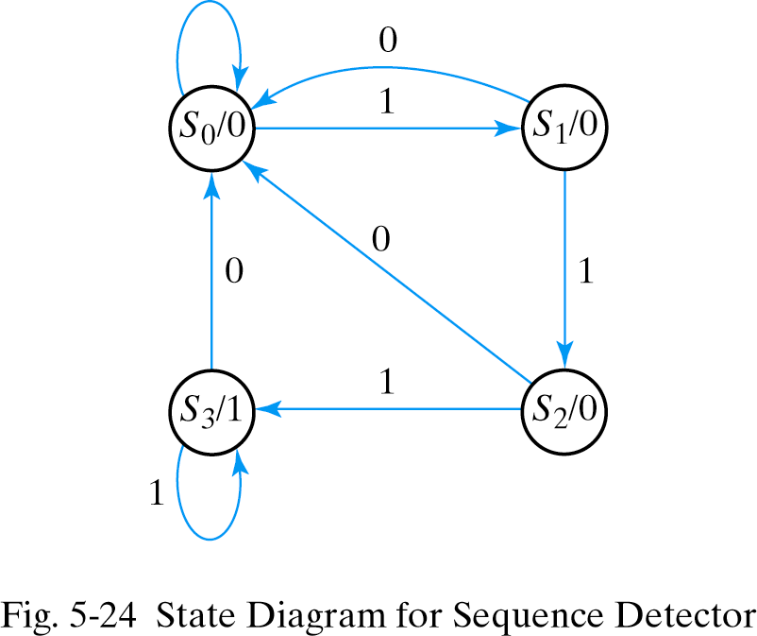
Develop State Diagram: Sequence Detector
Detect 3 or more 1s in sequence (a Moore Model)

Slide 29
D Flip-Flop Input Equations
A(t+1) = D_{A}(A,B,x) = Σ(3,5,7) B(t+1) = D_{B}(A,B,x) = Σ(1,5,7) y(A,B,x) = Σ(6,7)
State A B
0 0 0 0 0 1 0 1 1 0 1 0 1 1 1 1
Input x
0 1 0 1 0 1 0 1
Next State A B
0 0 0 1 0 0 1 0 0 0 1 1 0 0 1 1
Output y
0 0 0 0 0 0 1 1
Input equations come directly from the next state in D Flip-Flop design

Slide 30
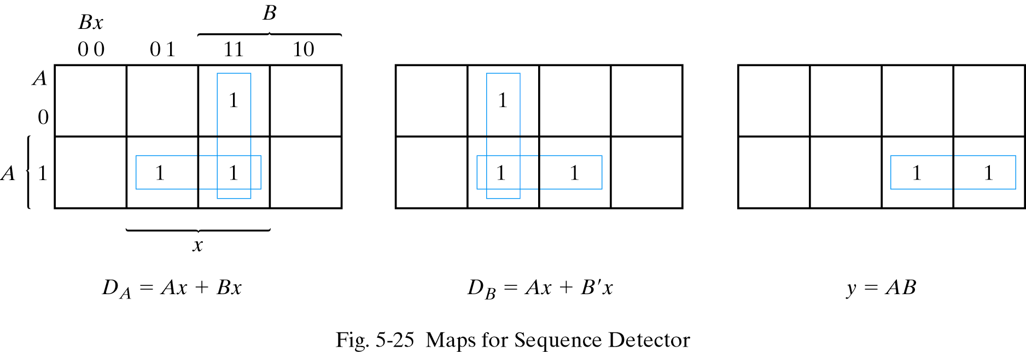
Simplified Boolean Equations

Slide 31
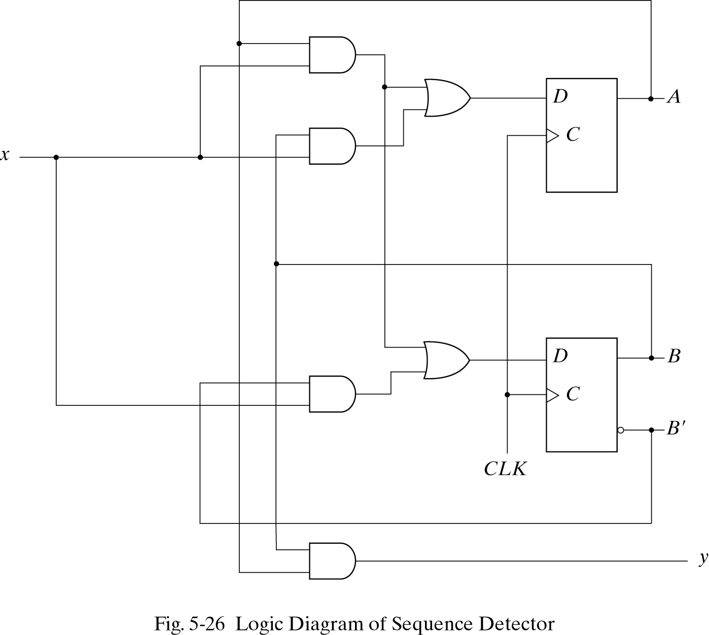
Sequence Detector: D Flip-Flops

Slide 32
Using JK or T Flip-Flops
1. Develop Excitation Table Using Excitation Tables
JK Flip-Flop
T Flip-Flop
Q(t)
0 0 1 1
Q(t+1)
0 1 0 1
J
0 1 X X
K
X X 1 0
Q(t)
0 0 1 1
Q(t+1)
0 1 0 1
T
0 1 1 0

Slide 33
State Table: JK Flip-Flop Inputs
Present State
Input
Next State
Flip-Flop Inputs
A
0 0 0 0 1 1 1 1
B
0 0 1 1 0 0 1 1
x
0 0 0 0 1 1 1 1
A
0 0 1 0 1 1 1 0
B
0 1 0 1 0 1 1 0
J_{A}
0 0 1 0 1 1 1 0
K_{A}
0 1 0 1 0 1 1 0
J_{B}
0 0 1 0 1 1 1 0
K_{B}
0 1 0 1 0 1 1 0

Slide 34
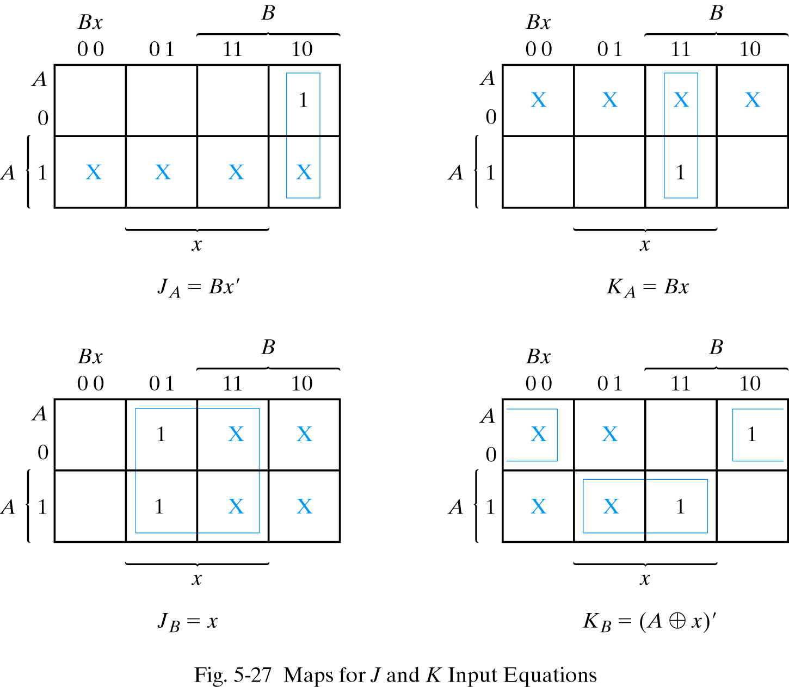
Maps for J and K Input Equations

Slide 35
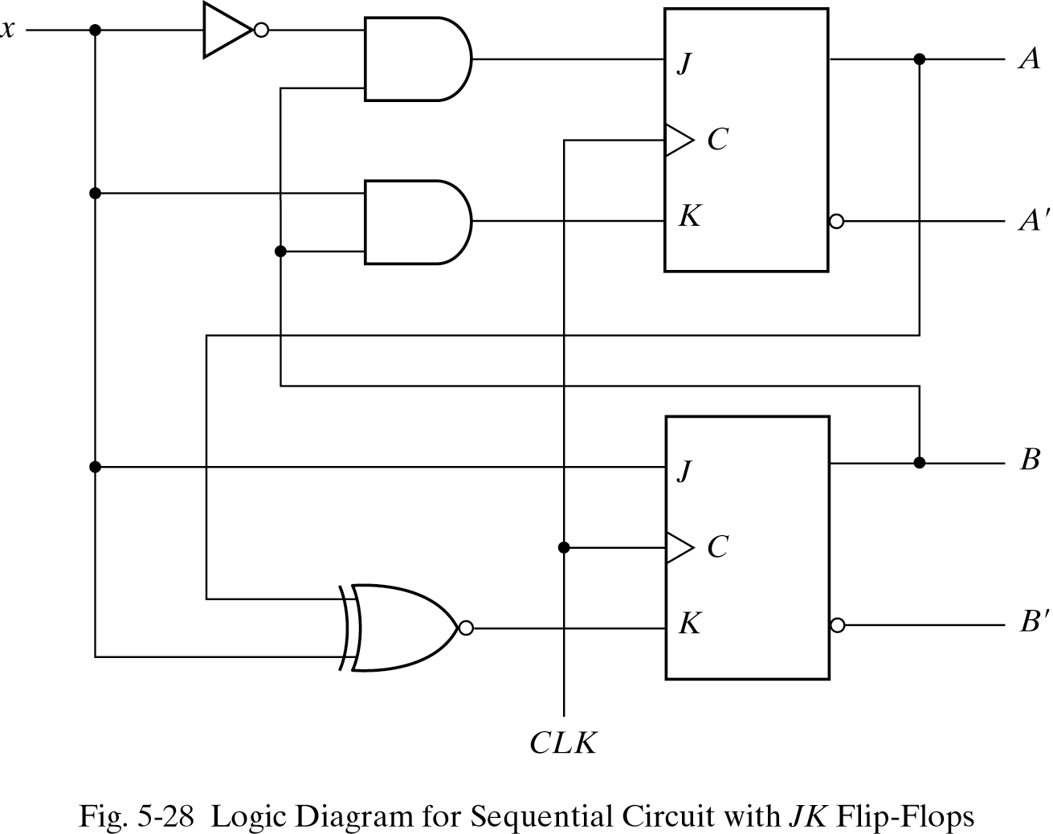
JK Flip-Flop Sequence Detector

